Slide 1

Stocks and Housing: How Local Can We Get?
Casey Hill
Sean Lane
Grace Hsu
UCB Extensions: Data Analytics Bootcamp Project 1 (Jan 14, 2019)

Slide 2
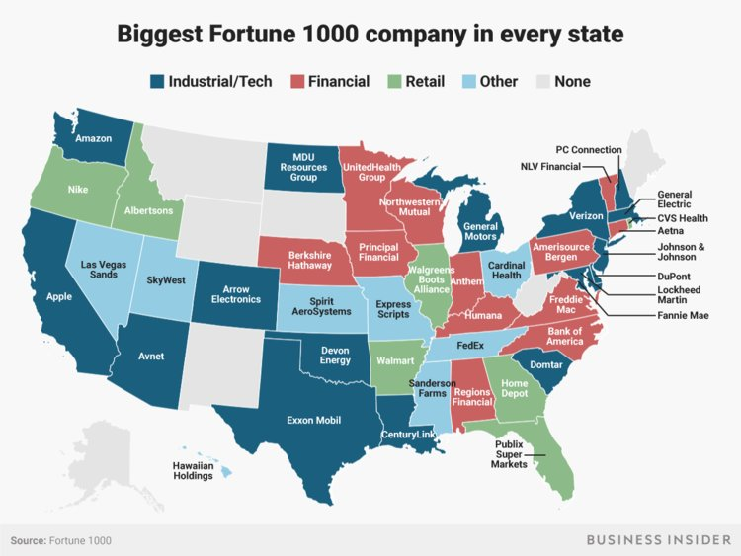
Hypothesis
Can a company’s stock value influence their headquarters housing market?

Slide 3
Questions
Is a company’s stock price and their headquarters housing market correlated during years 2005 to 2015?
Which company had the largest impact on the housing price in their headquarter’s city?
What correlation can we find between our hypothesis and the sub-categories of the companies? (Tech, Finance, Retail, Other)
Notes:
Is a company’s stock price and their headquarters housing market correlated during years 2005 to 2015?
Data: monthly stock close price and monthly median house sold price
Why: Could a period that has a high amount of fluctuation give enough representation of the two markets correlating?
Answered? YES
Which company had the largest impact on the housing price in their headquarter’s city?
Data: Largest fold-increase in housing price
Why: We can see what factors might also be at play and see if those factors correlate in future tests
Answered? YES
What correlation can we find between our hypothesis and the sub-categories of the companies? (Tech, Finance, Retail, Other)
Data: Grouping stock data by industry type, average monthly close price, average housing price of each of the grouped companies
Why: Our sub-categories may have a higher rate of correlation, therefore telling the larger story.
Answered? YES

Slide 4
Data Mining Summary
Business Insider/Forbes Fortune 1000
Manually created csv file with 20 companies (by largest revenue)
4 industry types: Retail, Finance, Tech, Other
QUANDL Python Library
Monthly stock close price by stock ticker
Monthly median house sale price by city
Import city codes
Import housing code
Years 2005-2015
Notes:
Notes on Mining:
Quandl API and Library
Gave us excess stock info:
Monthly High
Low
open
Close
Split
Adjusted stock info
Zillow/Quandl for Housing
Data came fully clean and correct

Slide 5
Data Exploration and Cleanup
Data Exploration and Cleanup Jupyter Notebook Hyperlink
Create DataFrames:
company, city, state, ticker, quandl code, industry type, quandl city area code
Monthly stock close price for each stock (2005-2015)
Monthly median housing sold price for each city (2005-2015)
Cleanup:
Removed companies with split stocks (NKE, CVS, ABC), except AAPL
Removed companies where no housing data could be pulled (SAFM, ANTM)
Removed companies where housing data was not accurate (CAH)
Notes:
From 300k to 2.5million

Slide 6
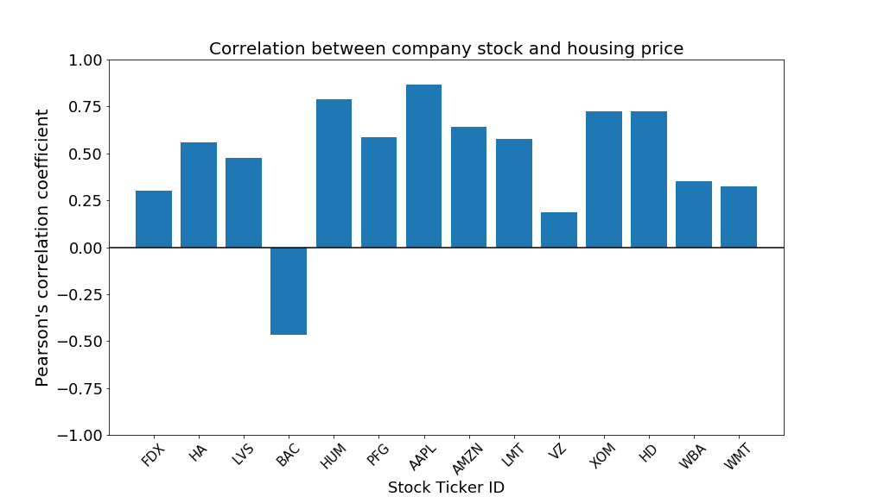
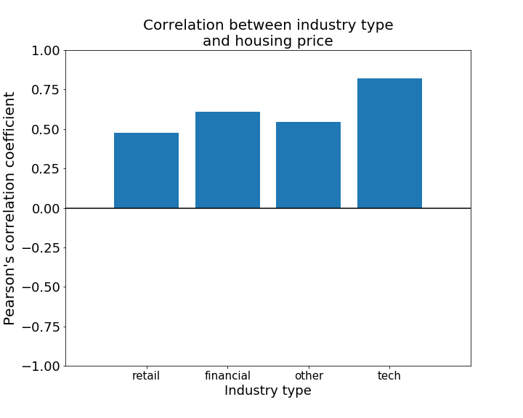
Analysis
Summary of analysis: Jupyter Notebook hyperlink

Slide 7
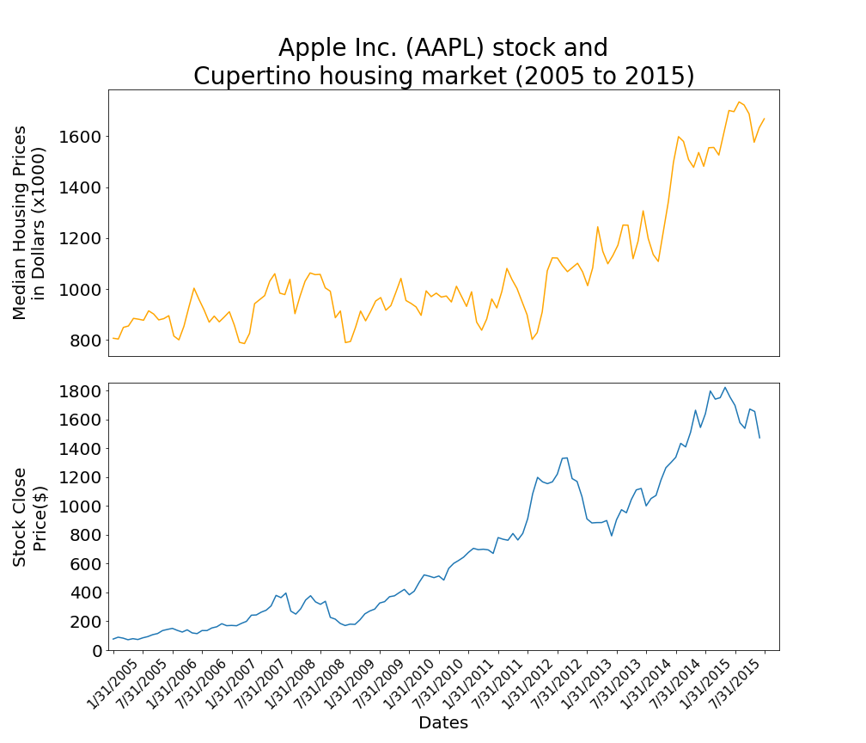
Pearson r : 0.866147
P Value : 2.26E-40

Slide 8
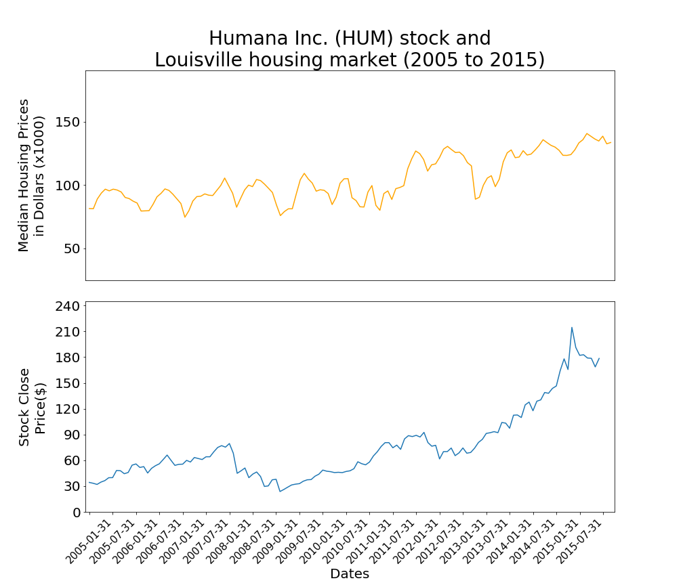
Humana is the 2nd largest employer in Louisville, KY. (9,854)
Pearson r : 0.78985244
P Value : 2.20E-29

Slide 9
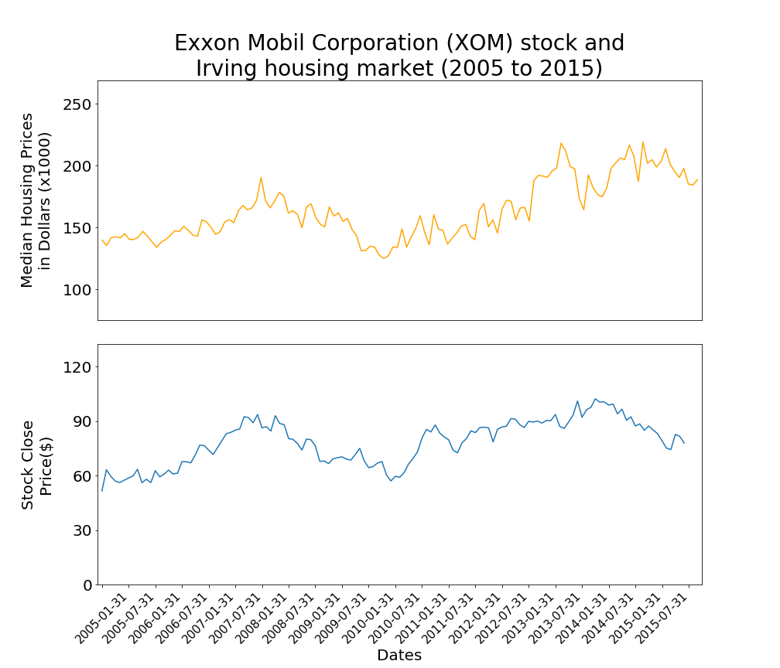
Exxon Mobile is the 9th largest company by revenue
Pearson r : 0.723121846
P Value : 1.23E-22

Slide 10
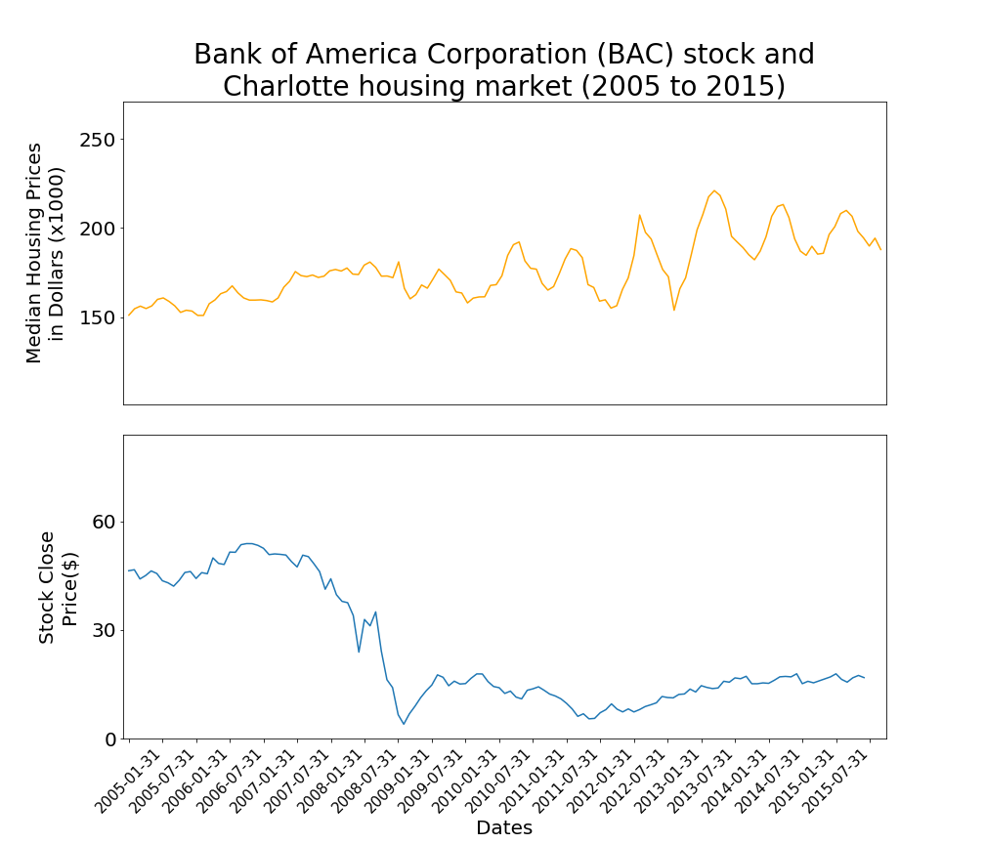
The Financial Crash of 2008-2009
Pearson r : -0.465546108
P Value : 1.86E-08

Slide 11
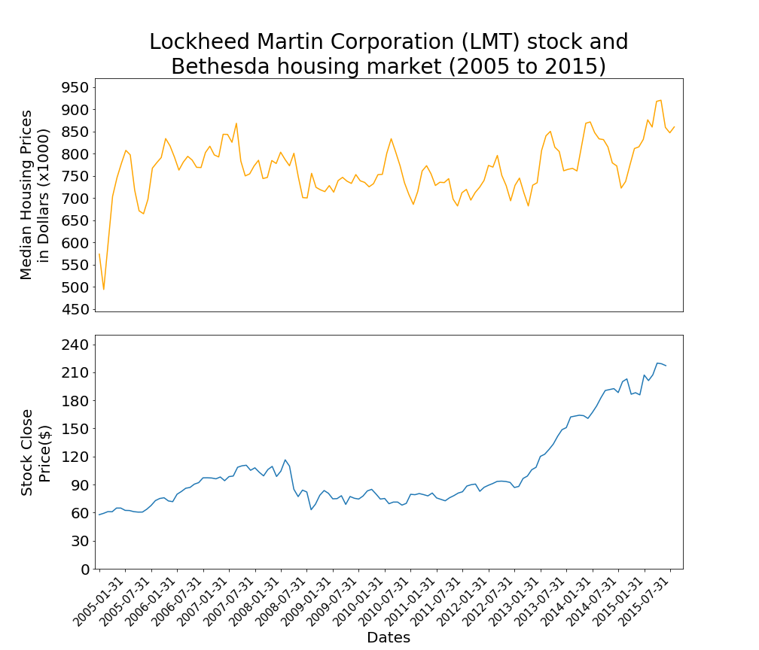
The median household income in North Bethesda, MD is nearly 2x the US average. ($103,000)
Pearson r : 0.577074
P Value : 15.42E-13

Slide 12
Conclusions
Hypothesis is proven correct
There is correlation between stock price and the housing price of the headquarters city during our selected time period
Hypothesis is not consistent across all sets of data
There is correlation below our threshold (.40) and at a negative correlation, therefore those companies do not support our hypothesis.
AAPL seems to carry the correlation across our map of data
Other factors affect our hypothesis
Correlation is less/ more effective based on other factors presented
Industry Type
City Size
Household Income
Notes:
Is a company’s stock price and their headquarters housing market correlated during years 2005 to 2015?
Which company had the largest impact on the housing price in their headquarter’s city?
What correlation can we find between our hypothesis and the sub-categories of the companies? (Tech, Finance, Retail, Other)
Other difficulties:
Dealing with Split stocks
Housing Data issues arose from

Slide 13
Implications
For Companies
The search for a new headquarters can factor the population size and household income along with any other factors
Lower household income = more incentive from a city to build inside their limits
Lower population = Less of a workforce to pull capable employees
For Cities
There are new factors to look for when bringing a company into your city limits
Company Stability: If your household income is low, the success of the company will dictate the success of your city economically.
Company growth = city growth; BUT
Company losses = city losses
Other factors can mitigate the impact of the company
Notes:
Low Median Household income has the largest impact on correlation
If the city has a low household income, a companies success determines the economic value of the city
City Population affects the correlation of stock and housing, but not to the extent of Household income
High population shows a lower correlation factor, but to only a degree of effectiveness – NYC is an exception due to the difference in population to other samples
Industry Type has an effect on correlation
Financial and Tech organizations tend to have a higher correlating factor than
Headquarters may have higher percentage of company population
Financial: Office environment for large population of company
Tech: Large headquarters as part of company culture
Also pays higher on average, so does not support hypothesis

